Slide 1

COM3123 - Lecture 5
Angular Routing & Reusable Components

Slide 2
Topics
Reusable Components
Routing & Navigation

Slide 3
Reusable Components

Slide 4

Reusable Components
Components are the basis of modern SPAs (Angular, Vue, React). They are the simplest building blocks of SP applications.
A SPA app is a tree of components, it starts with the root component, going up spreading into multiple branches.
The Components are composable, they build up an app by stacking the components on each other like LEGO blocks.

Slide 5
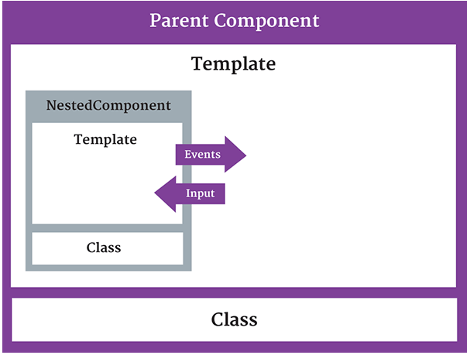
Nested Components
We can add a nested component by using a component as a directive within
another component (Parent)
@Input() and @Output() act as the API, or application programming interface, of the child component in that they allow the child to communicate with the parent.

Slide 6
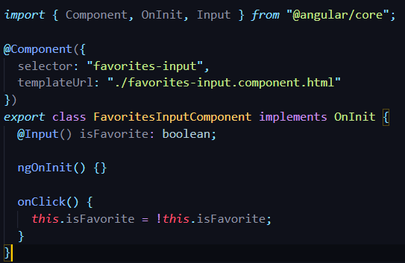
@Input Decorator
@Input decorator allows data to flow from parent component to child
An @Input() property is writable and it’s property name can be Aliased

Slide 7
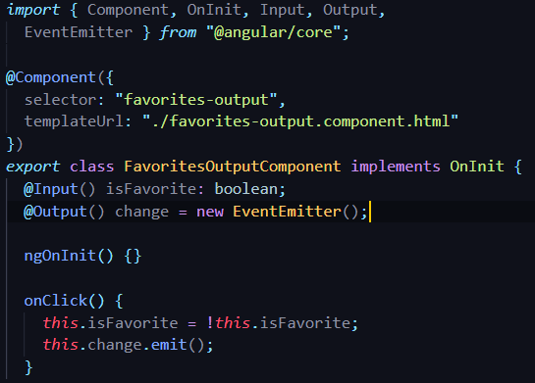
@Output Decorator
@Output() property is observable.
@Output decorator exposed an EventEmitter property that emits events to parent component

Slide 8

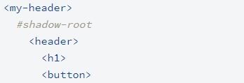
Shadow DOM
Shadow DOM is a DOM feature that helps you build components. You can think of shadow DOM as a scoped subtree inside your element.
Shadow DOM lets you place the children in a scoped subtree, so document-level CSS can't restyle the button by accident, for example. This subtree is called a shadow tree.
There are many ways to ensure encapsulation, Iframes being the most popular. Shadow dom is a newer, crisper, and an easier way to achieve the same.

Slide 9
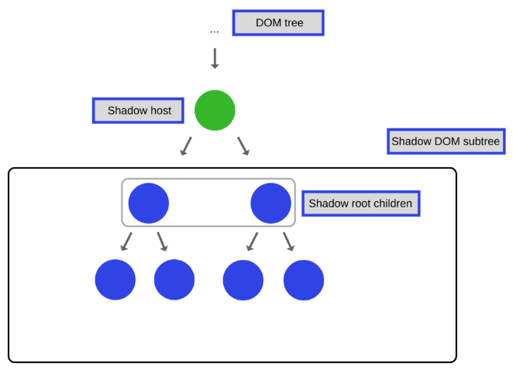
Shadow DOM cont..
The shadow root is the top of the shadow tree.
The element that the tree is attached to is called the shadow host.
The shadow tree is separate from the element's children. You can think of this shadow tree as part of the component's implementation, which outside elements don't need to know about.

Slide 10
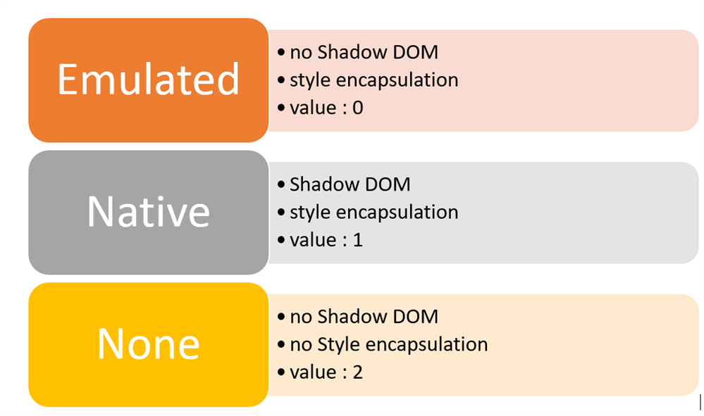
ViewEncapsulation
Using the Shadow DOM, markup, styles, and behaviors are scoped to the element and do not clash with other nodes of the DOM
To emulate the Shadow DOM and encapsulate styles, Angular provides there types of View Encapsulation

Slide 11
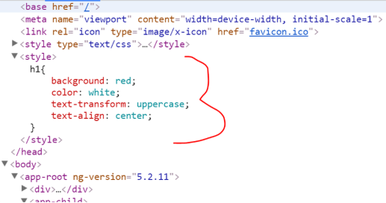
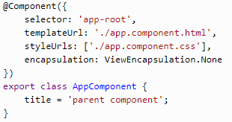
ViewEncapsulation.None
In the browser, the h1 style has been declared in the head section of the DOM.
There is no Shadow DOM
Style is not scoped to component

Slide 12
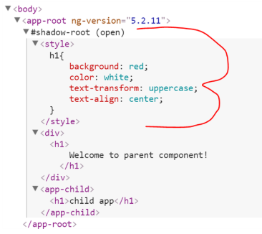
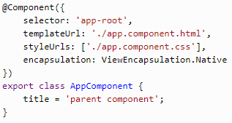
ViewEncapsulation.Native
In the browser, a Shadow DOM has been created for the AppComponent and the style is scoped to that.
Angular will create Shadow DOM for the component.
Style is scoped to the component.

Slide 13
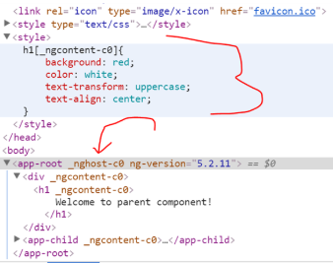
ViewEncapsulation.Emulated
Angular has created the style in the head section of the DOM and given an arbitrary id to the component. On basis of ID, selector style is scoped to the component.
Angular will not create a Shadow DOM for the component.
Style will be scoped to the component.
This is the default value for encapsulation.

Slide 14
Routing

Slide 15
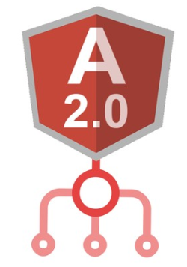
What is Routing?
Routing is the process of switching in-between multiple view based on selected path to display data in the web browser.
Routing provides a way for the user to navigate between many of the views of the application. ie. there can be 100-1000s of views.
In Angular, we can configure routes and tie routes to actions, and we can defined where to place the routed component's view.

Slide 16
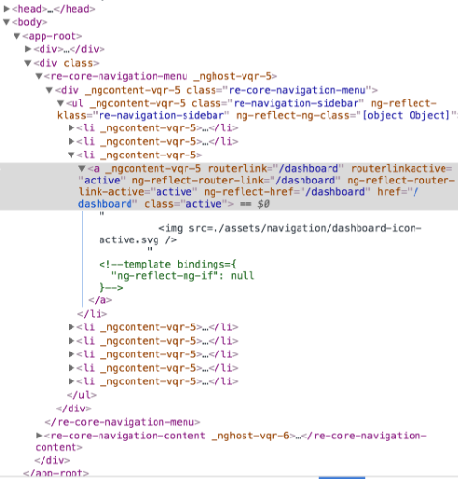
SPA Views
An Angular application is a single-page application. That means all of our views are displayed within one page, normally defined in the index.html file.
The views take turns appearing on that one page. That's the purpose of routing is to manage which views to display.
We configure a route for each component that wants to display its view on the page.

Slide 17
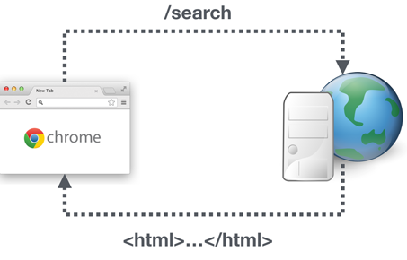
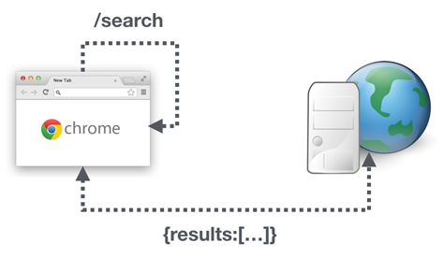
How does Routing Work?
Configure a route for each component
Define options/actions ie. button click, navigation menu link
Define a route to each option/action
Activate the route based on the user action
Activating a route displays the component's view (ie. User selects Video list, video list route is activated and it display the components view)
Server Routing Request vs Client Routing Request

Slide 18
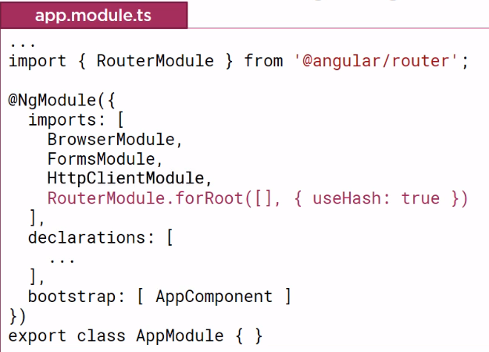
Configure Router
An Angular application has one router that is managed by Angular's router service.
We need to register the service provider in an Angular module, before we can use it. ie. similar to HTTP module
By importing the RouterModule we can use the router directives ie. router link and router outlet
forRoot() and forChild()...latter is for relative routes.
https://angular.io/guide/router#router-outlet
https://angular.io/guide/router#router-links

Slide 19


Hash style routes vs HTML5 style routes
HTML5 route style is default, we need to configure router to use hash routes
The URL will contain data prepended with # character, called the hash fragment (Originally used for anchor tags/scroll to section)
The hash fragment, never gets sent back to server, it also stores state of your client application
URL can be bookmarked, won't confuse server-side, can be changed via JavaScript - ideal for client side routing

Slide 20
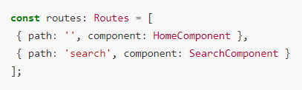
Configuring Routes
The mapping of URLs to Components we want displayed on the page is done via a Route Configuration. It is an array we defined routes in.
The path property describes the URL this route will handle.
The component property is the name of the component we want to display when the URL in the browser matches this path.

Slide 21
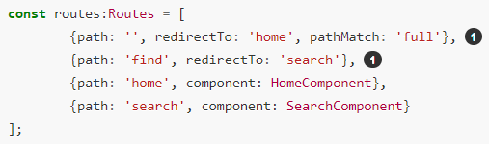
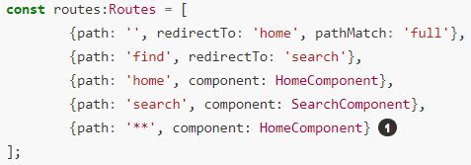
Route Redirects & Catch All Route
There are a few more ways to configure routes..
The redirectTo property describes the path we want to redirect the user to if they navigate to this URL
We can also add a catch all route by using the path **, if the URL doesn't match any of the other routes it will match this route
Order matters! The router uses a first match win strategy. More specific routes first.

Slide 22

Navigating Application Routes
Route Configuration handles the following:
Typing in the Url in the address bar/bookmark
Browser's forward or back buttons
We need to handle the tying routes to actions for HTML elements ie. Menu option, link, button etc.

Slide 23
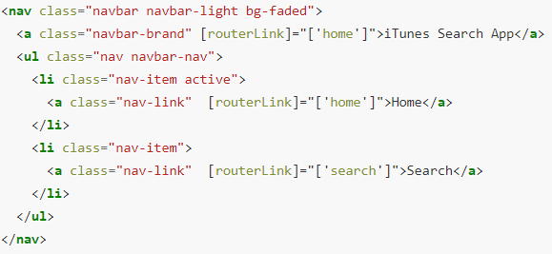
routerLink
We can also control navigation by using the routerLink directive in the template itself
The routerLink directive takes as input the same link params array format that the router.navigate(…​) function takes.
routerLinkActive directive can be used to give feedback on active route

Slide 24
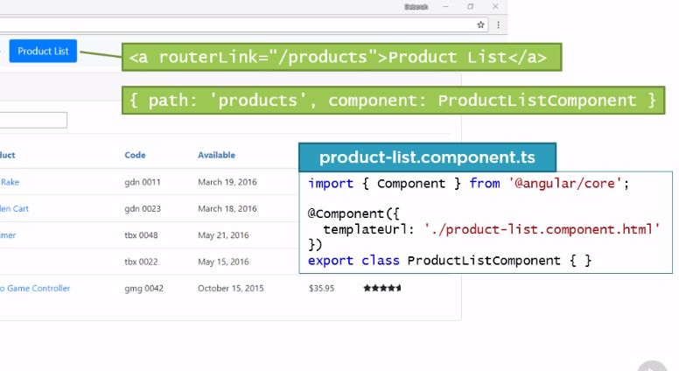
Routing Link to Component

Slide 25
Navigation & Routing

Slide 26


Passing Parameters to Routes
Sometimes we need part of the path in one or more of our routes (the URLs) to be a variable, a common example of this is an ID.
We need to pass the ID part of the URL to the component by using a Parameterised Route
A path can have any number of variables as long as they all start with : colon and have different names
Non-parameterised routes take precedence over parameterised routes!

Slide 27


Reading Parameters from a Route
We pass the value of ID from URL to the Component by using an ActivatedRoute
The ActivatedRoute needs to be imported and then injected into the Constructor
If it is a static value that will not change, we can use the snapshot of the route parameters
Otherwise, if the path variable is dynamic, we can subscribe to an Observable to track changes of the value

Slide 28
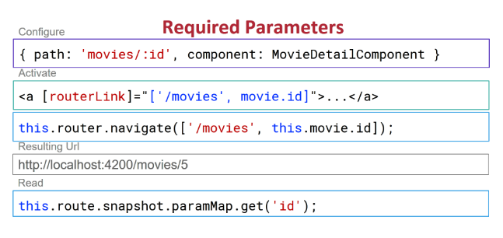
Sending data through routing paths

Slide 29


Activating Routes in Code
Instead of using the routerLink, we might want to route in code in some cases, (ie. Save button >> execute save and redirect)
We need to import the Router Service and define it as a dependency by injecting it in Constructor
We use the router navigate or navigateByUrl to route back to a configured route

Slide 30
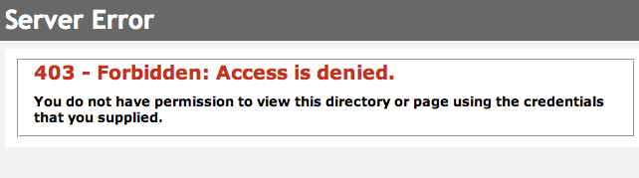
Router Guards
In traditional server side applications, we would check permissions on the server and return 403 error page if user didn't have permissions.
We can do the same in client-side SPA with router guards.
With Router Guards we can prevent users from accessing areas they are not allowed access to

Slide 31
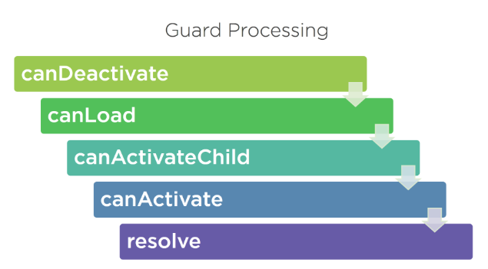
Router Guard Types
CanActivate
Guard navigation to a route
CanDeactivate
Guard navigation from a route
Resolve
Pre-fetch data before activating a route
Some other routes..CanLoad, CanActivateChild

Slide 32
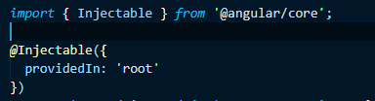

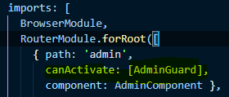
Creating an Router Guard
Guards are implemented as services that need to be provided so we typically create them as @Injectable classes.
Guards return either true if the user can access a route or false if they can’t.
They can also return an Observable or Promise that later on resolves later. Angular will keep the user waiting until the guard returns true or false.

